Slide 1
StoryBoard
Habitual Desktop App
Isd project Ahmad Fares
11932981

Slide 2
Section 1 GUI/UX
Different forms

Slide 3
Login Page
User Name
Password

Slide 4
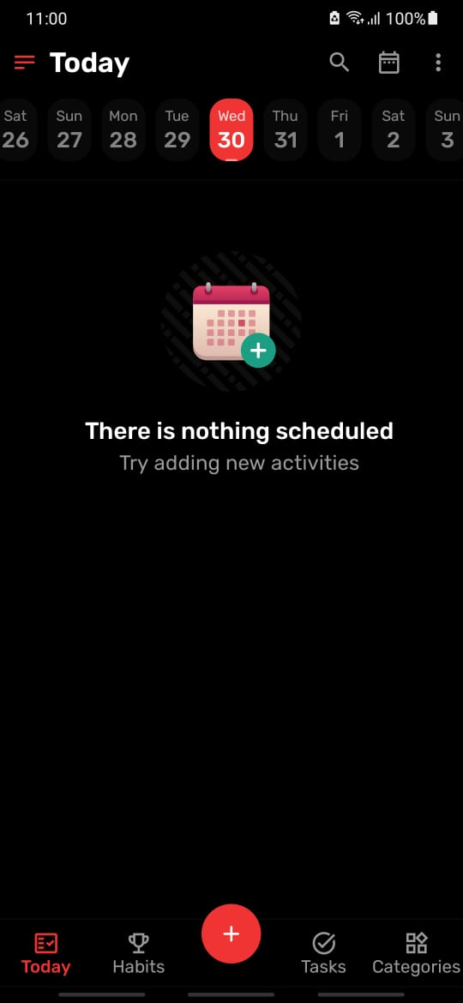
Calendar
Slider
Tasks are checked at 0:00 am, with a Boolean counter,
Normal tasks are not tracked.
Recurring tasks are.
Tasks are different than habits
Home Page

Slide 5
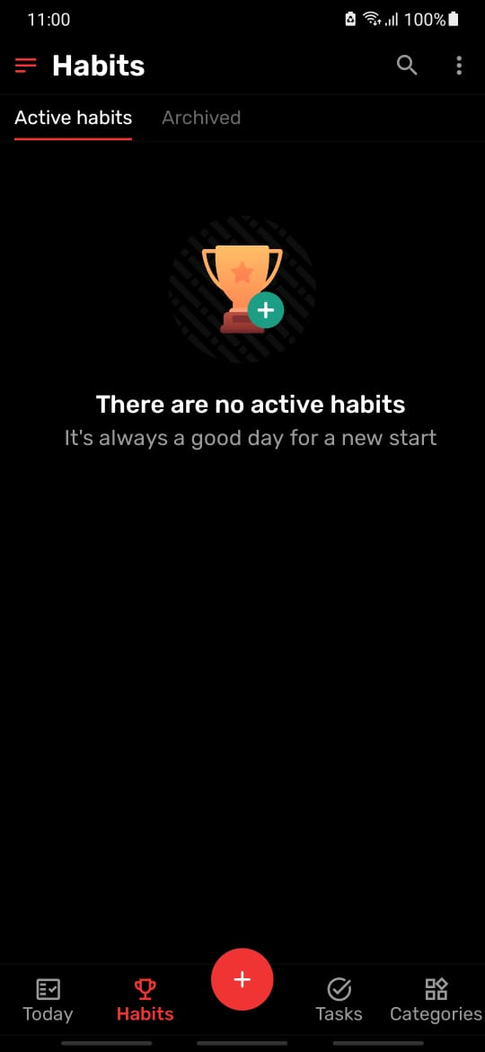
Habits are tracked with
A percentage
Habits that are paused or stopped will not be tracked

Slide 6
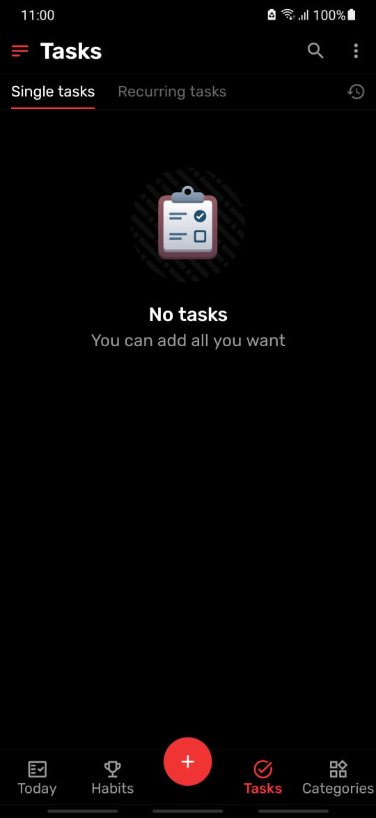
Recurring Tasks are Tracked with a Boolean & numeric (assessed weekly)
Manages single tasks.

Slide 7
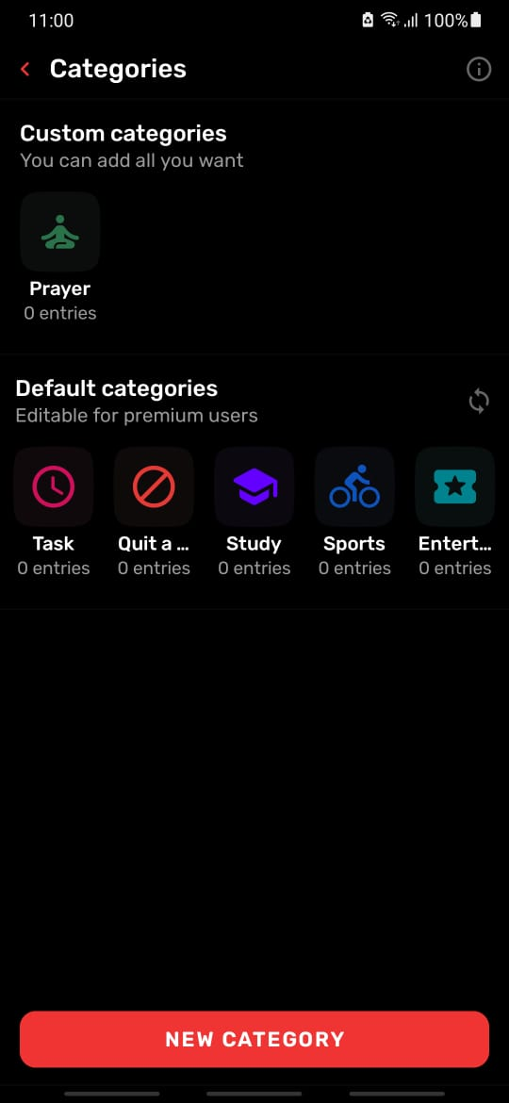
Habit Organizer
Allows detailed tracking of individual habits, recurring tasks are a category
Saves user progress daily and sets recommendation based on result

Slide 8
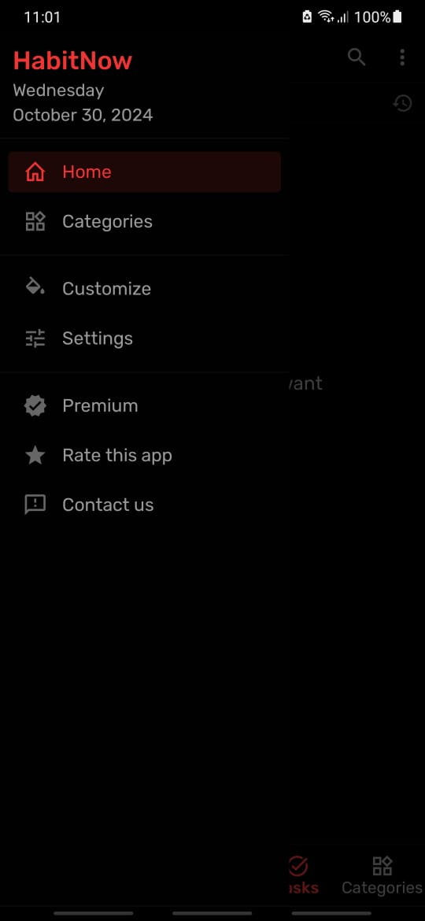
Sidebar(quick access)

Slide 9
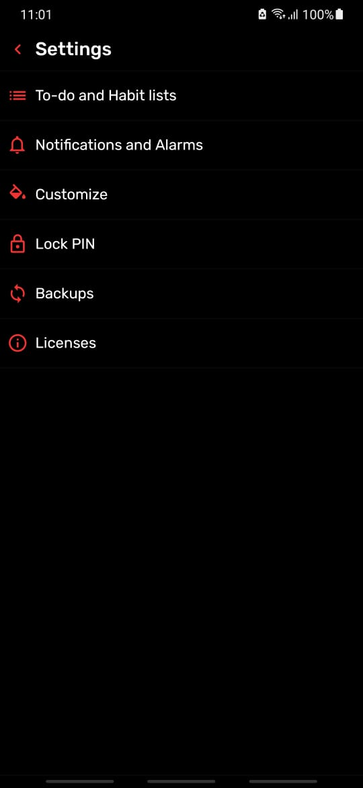

Slide 10
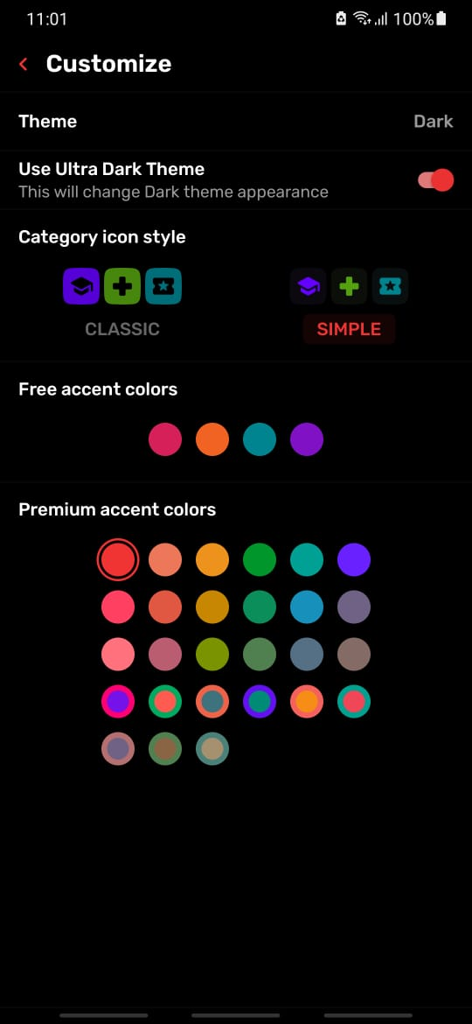

Slide 11
Use case Scenario
Creating tasks , habits & tracking.

Slide 12
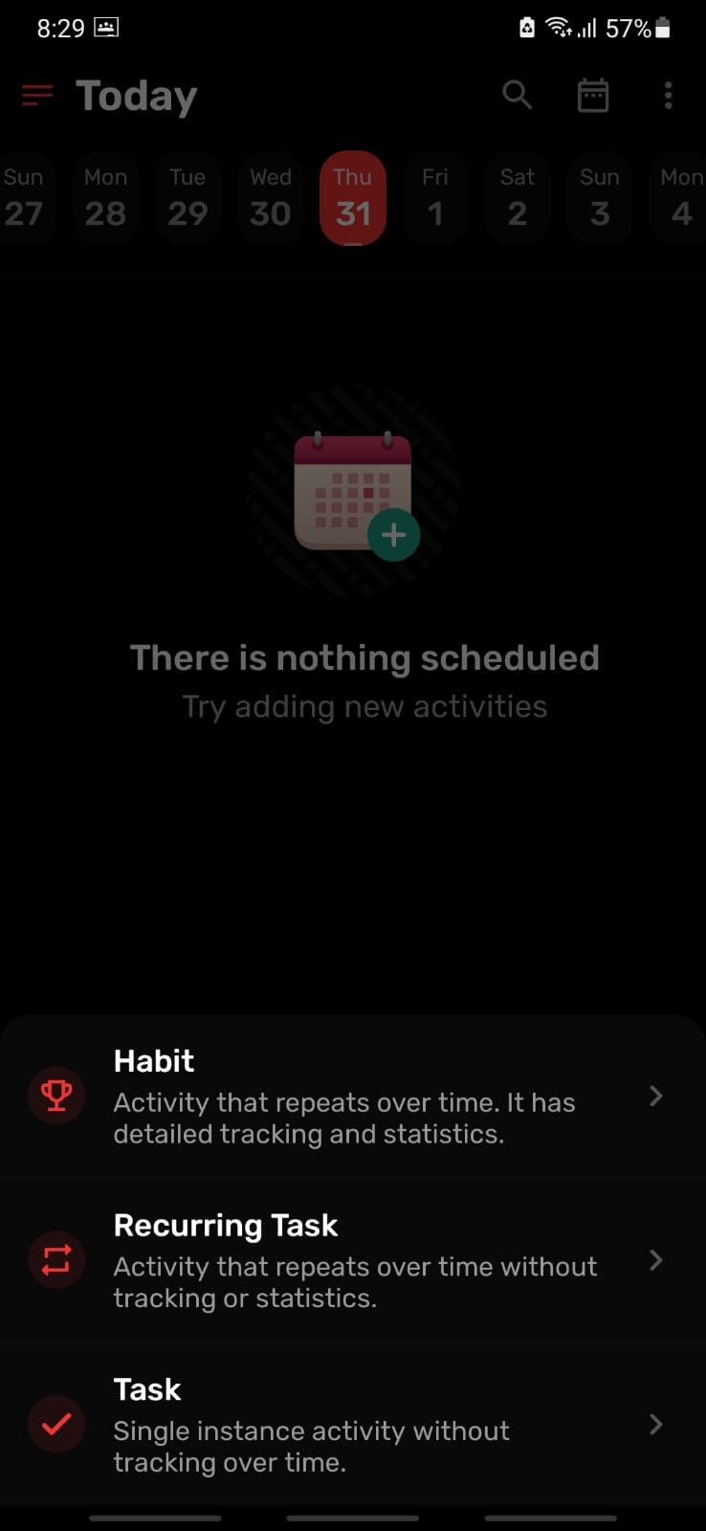
Plus button opens 3 entries

Slide 13
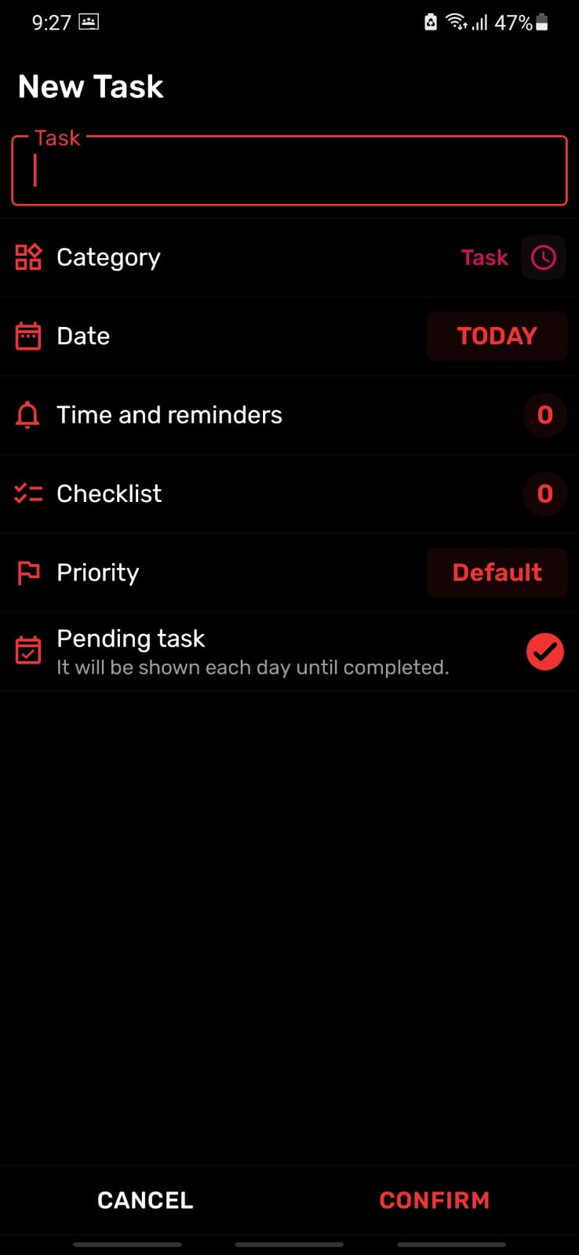
Task entry
(single)

Slide 14
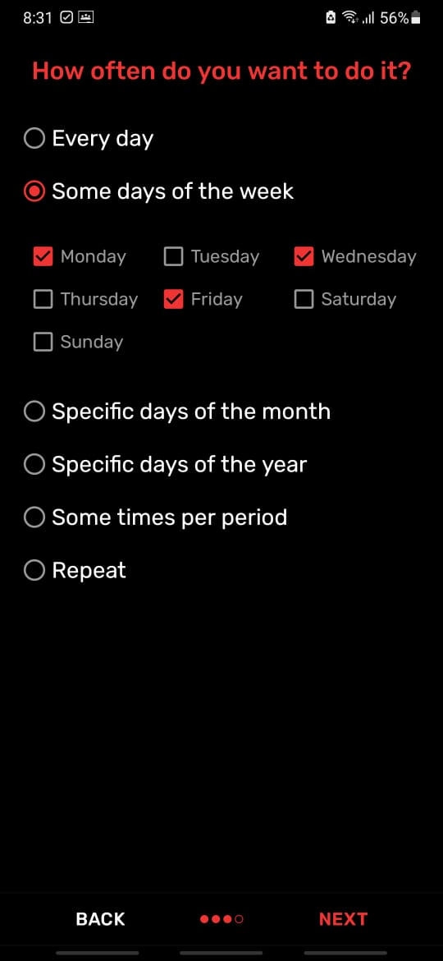
Recurring task

Slide 15
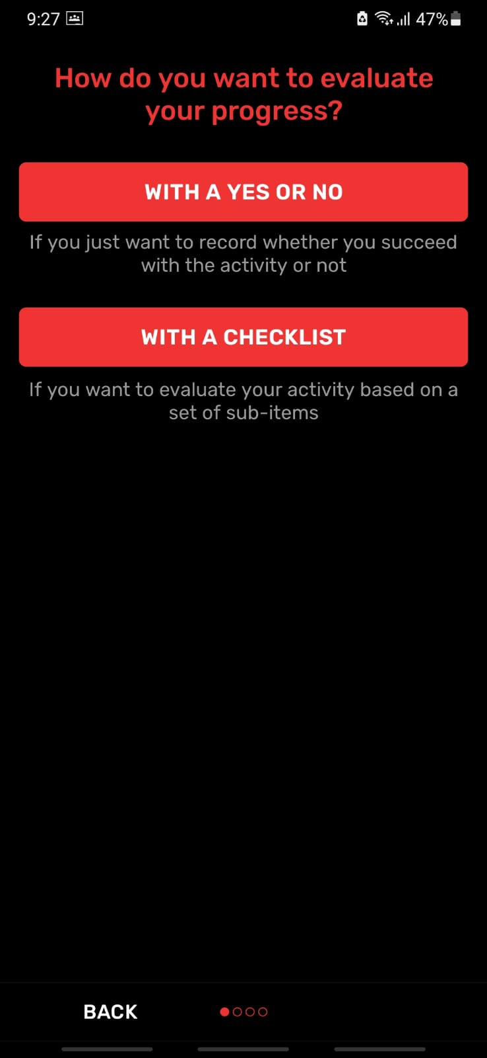
Recurring task:
Boolean or list

Slide 16
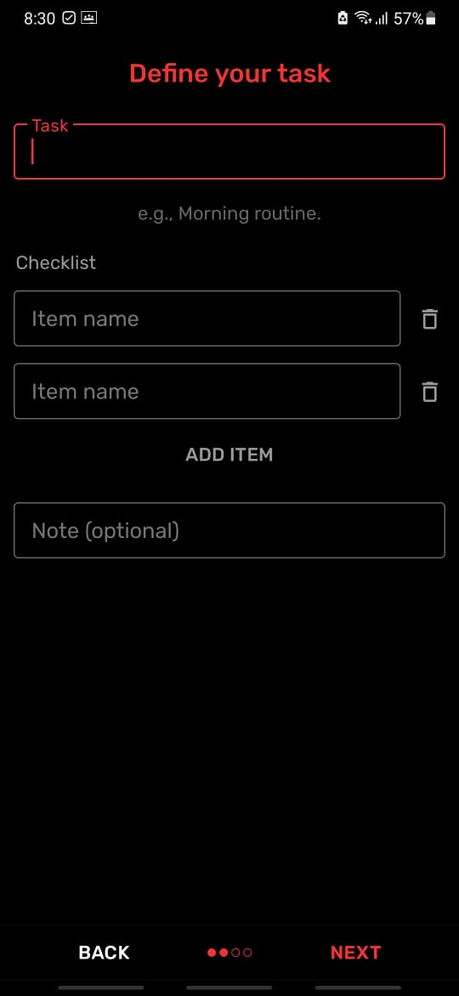
Checklist will be converged to percentage each day

Slide 17
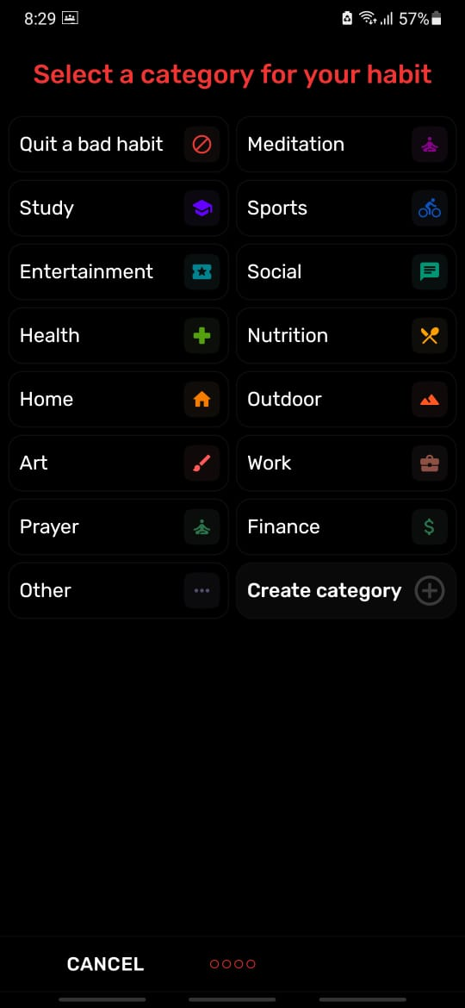
Habit Page

Slide 18
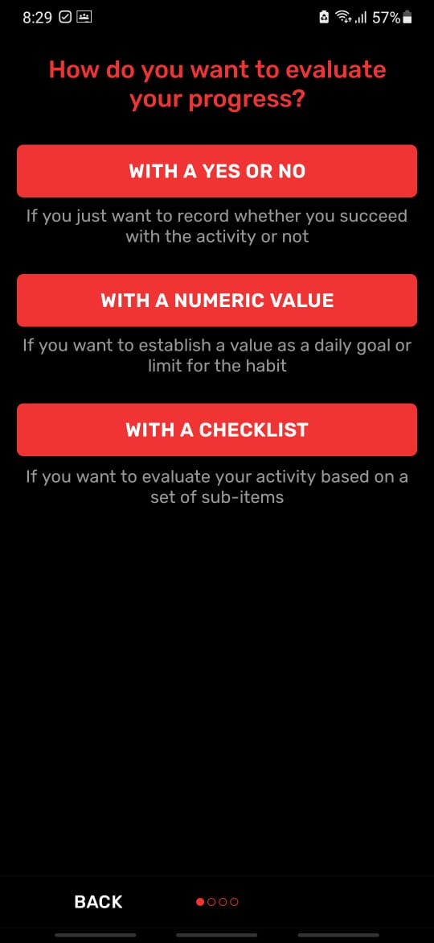
Numeric counter option for habits

Slide 19
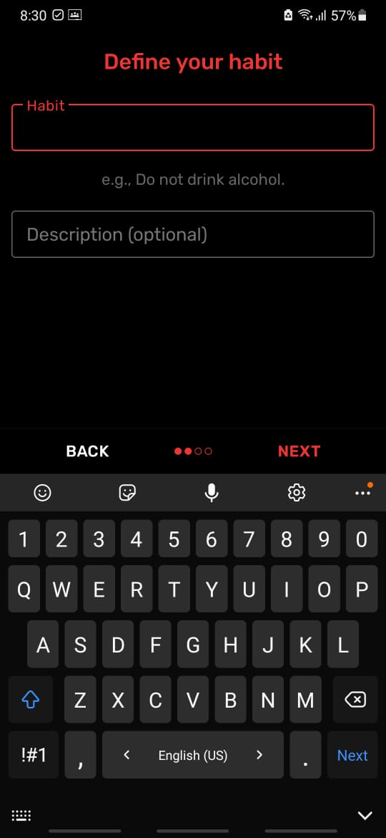
Habit define

Slide 20
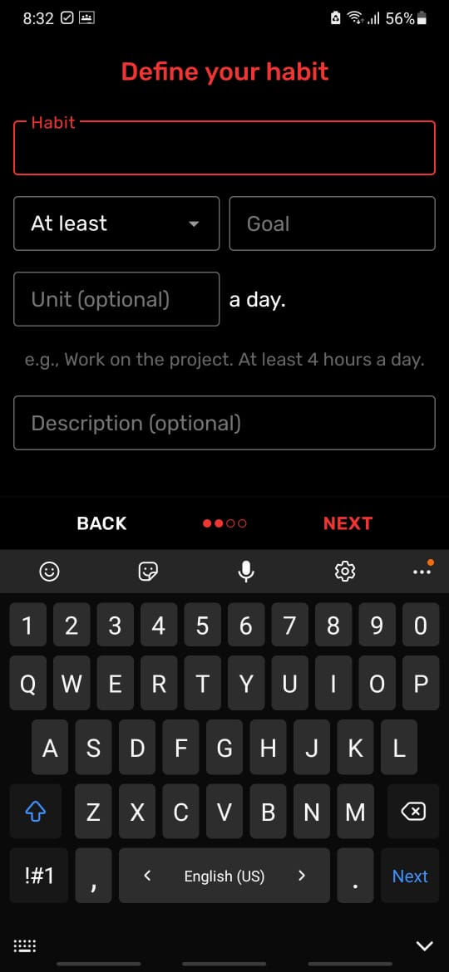
Numeric define

Slide 21
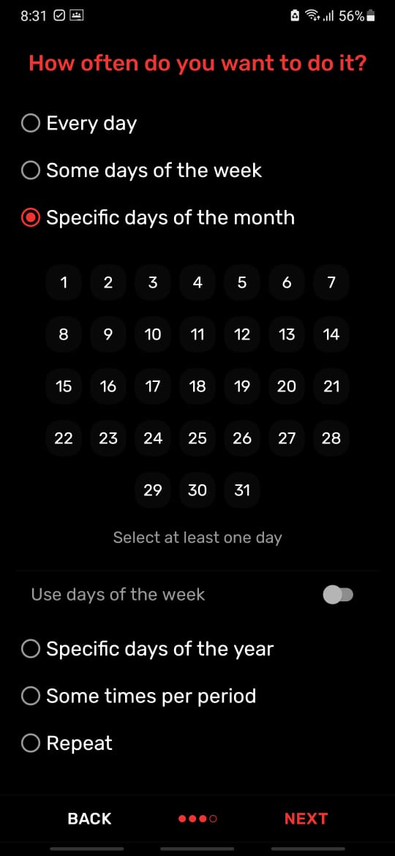
Same as recurring

Slide 22
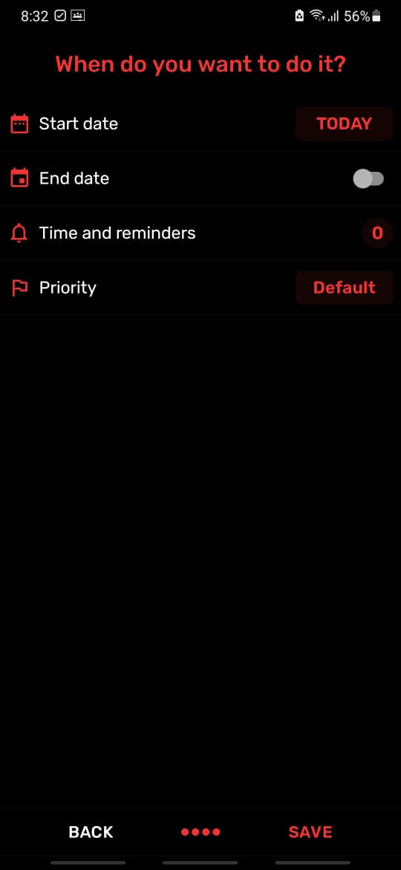
Start & end
(or open ended)

Slide 23
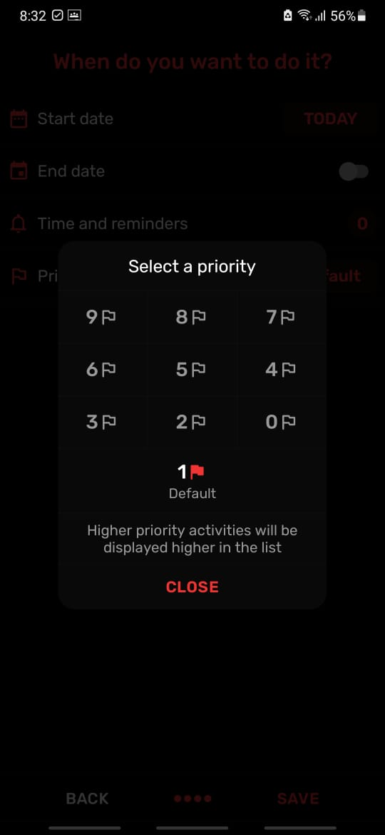
Priority for habits will effect recommendation plan

Slide 24
Software used
Windows visual studio: windows forms app
Xamp: database for habit categories
Note: I will create the recommendations code after 1 week of evaluation. (implement machine learning).
If successful and there is still time AI voice implementation.

